Slide 1

ANALYSIS OF ENERGY CONSUMPTION PATTERNS IN THE UNITED STATES
By Datawizards
Manidedeepya Chennapragada,Kalyan Vikkurthi,Dharnidhar Reddy Banala, Nikhil Mylarusetty

Slide 2
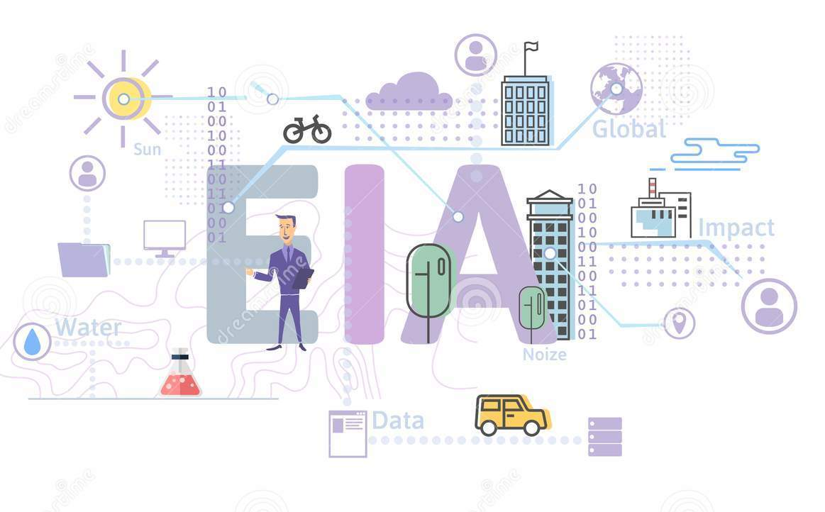
Introduction
Energy consumption patterns in the United States have a significant impact on the economy and the environment.
Analyzing energy consumption patterns involves collecting and analyzing data on energy use to identify trends and patterns.
Key factors that influence energy consumption patterns include population growth, economic activity, technological advancements, energy prices, and government policies and regulations.
Analyzing energy consumption patterns is important for developing effective energy policies and strategies.
This analysis can help identify areas for improvement and inform strategies for promoting more sustainable and efficient energy use.

Slide 3
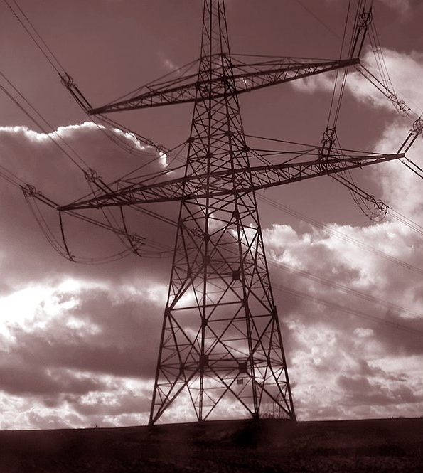
Motivation
Effective monitoring and management of energy usage is critical for promoting sustainable and efficient energy use.
Kafka's scalability and fault-tolerance make it a reliable platform for handling large-scale energy data analysis projects.
Analyzing energy consumption patterns using Kafka can help identify areas for improvement and inform the development of more effective energy policies and strategies.

Slide 4


What is Kafka?
Apache Kafka is an open-source distributed event streaming platform

Slide 5
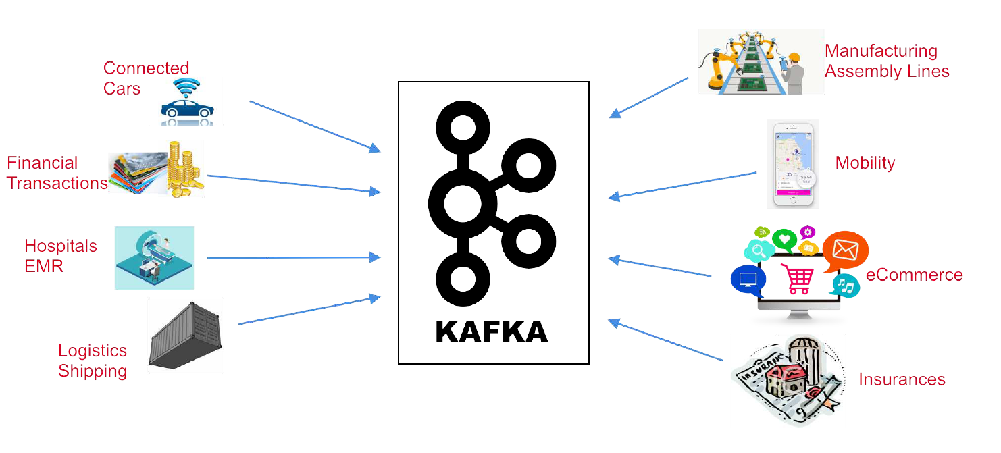
The World Produces Data

Slide 6
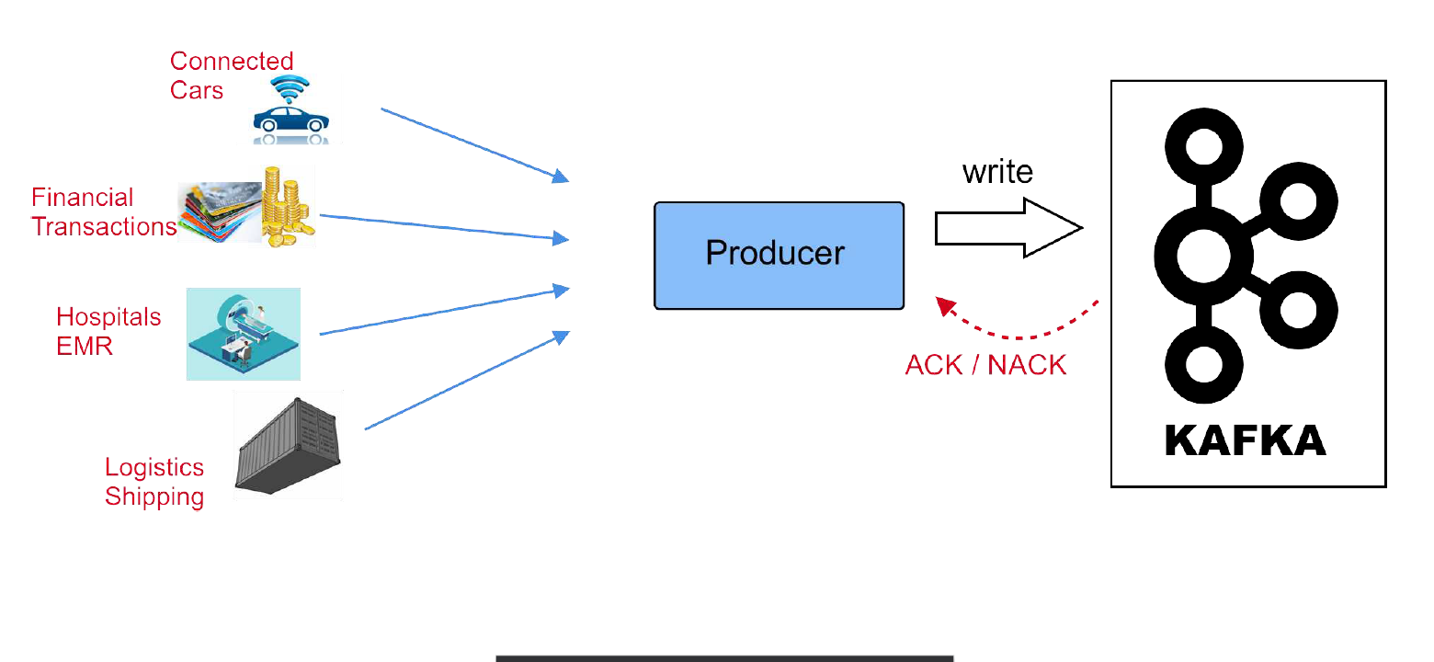
Producer

Slide 7
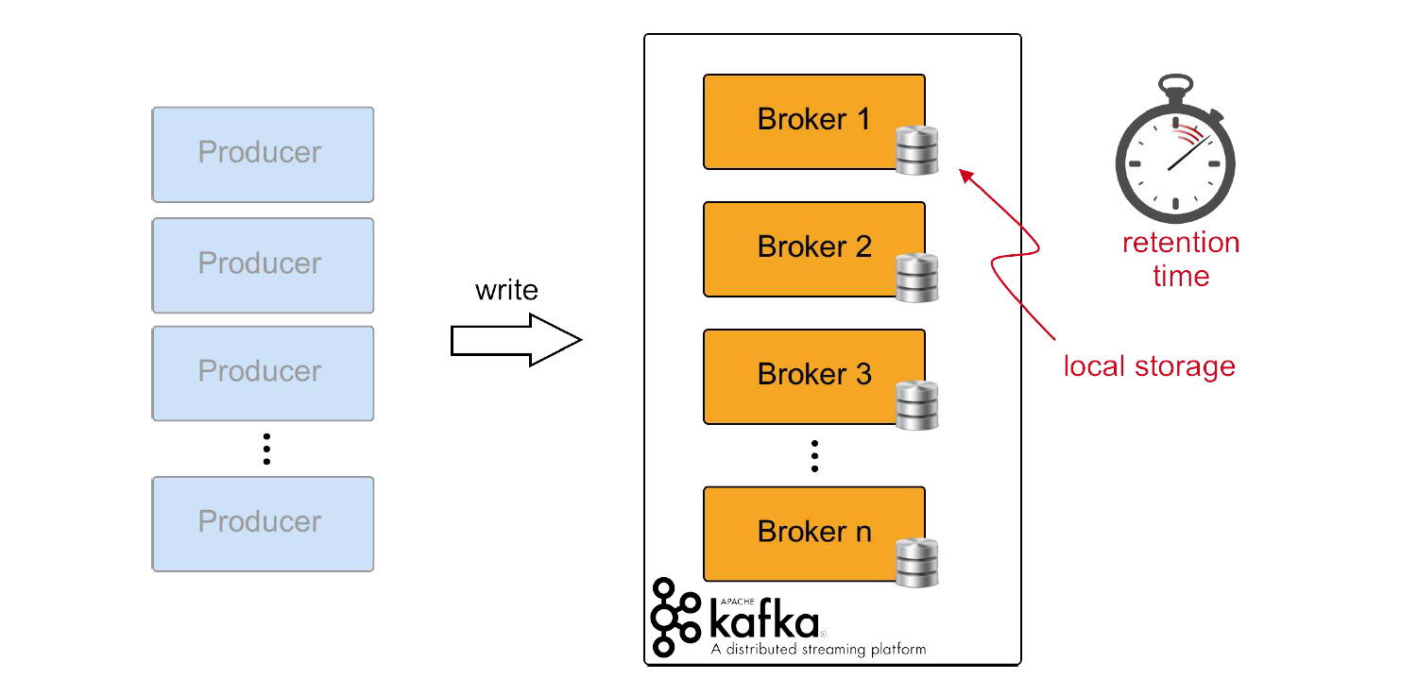
Kafka Broker

Slide 8
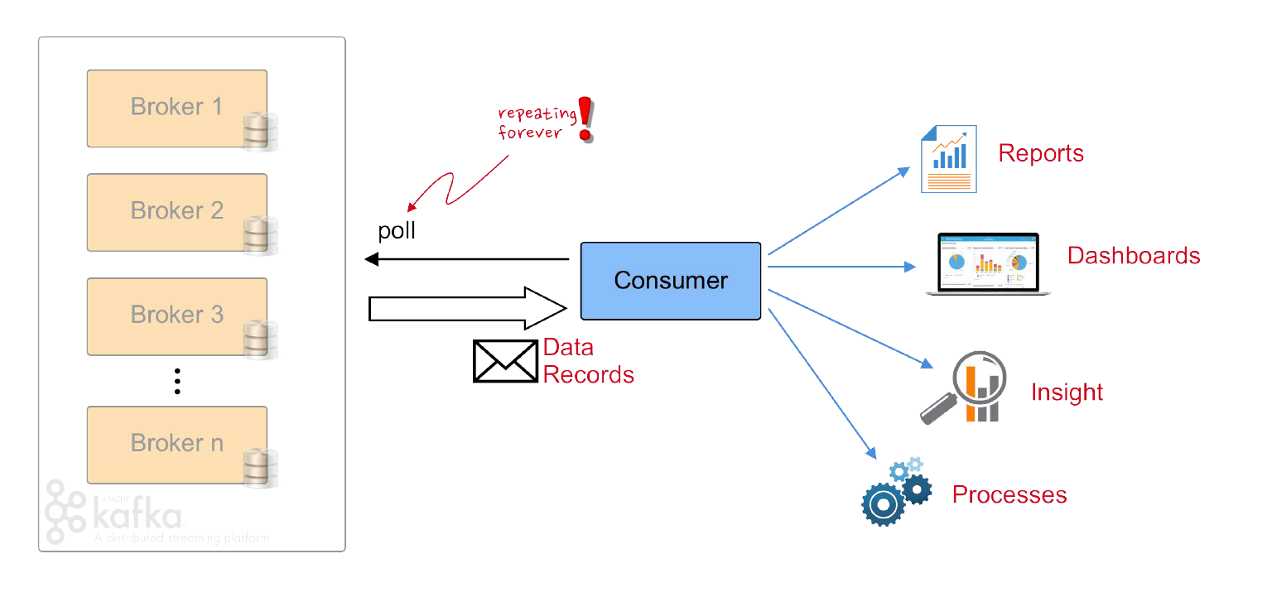
Consumer

Slide 9
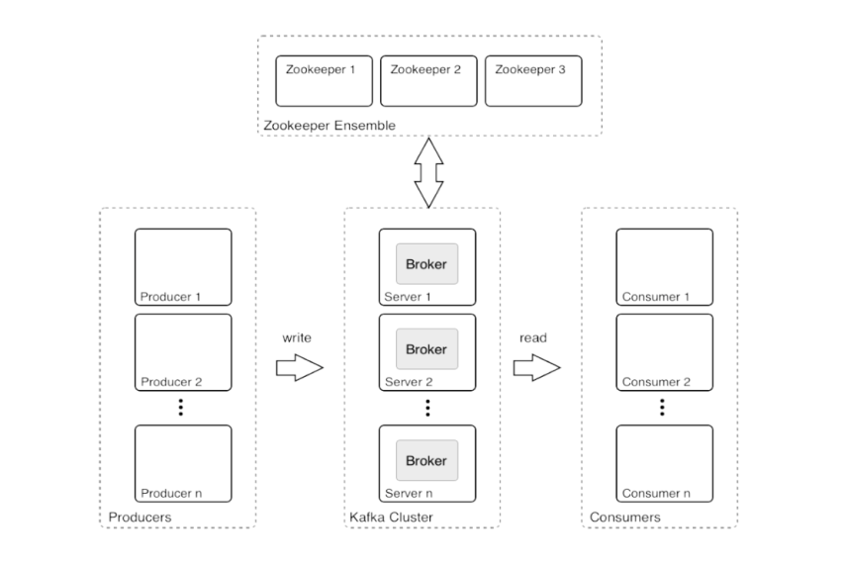
Kafka Architecture

Slide 10
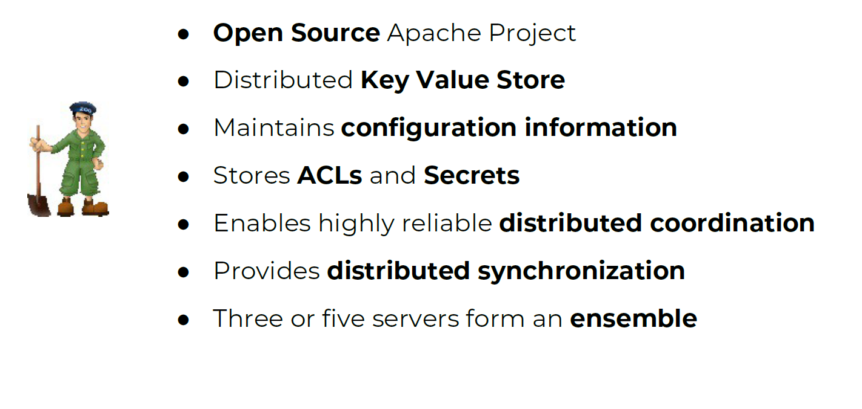
ZooKeeper

Slide 11
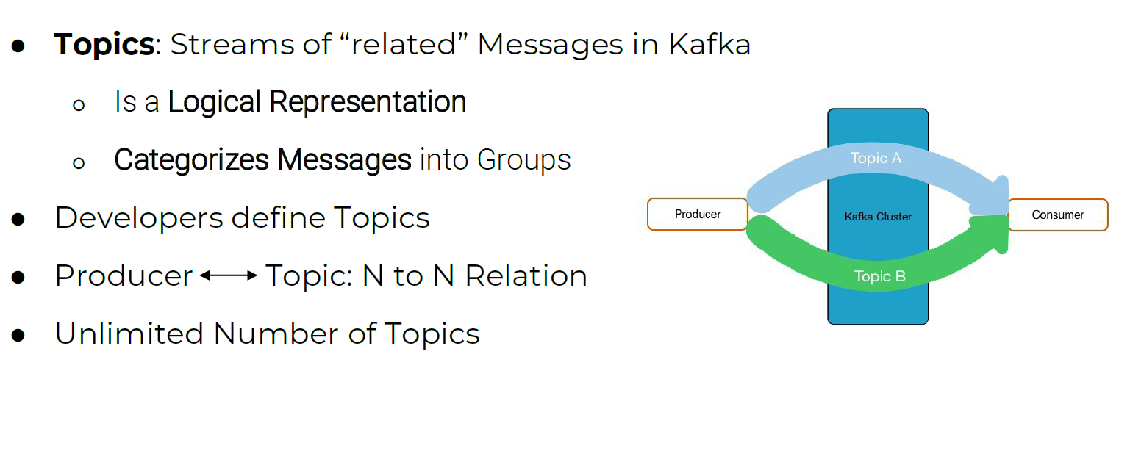
Topics

Slide 12
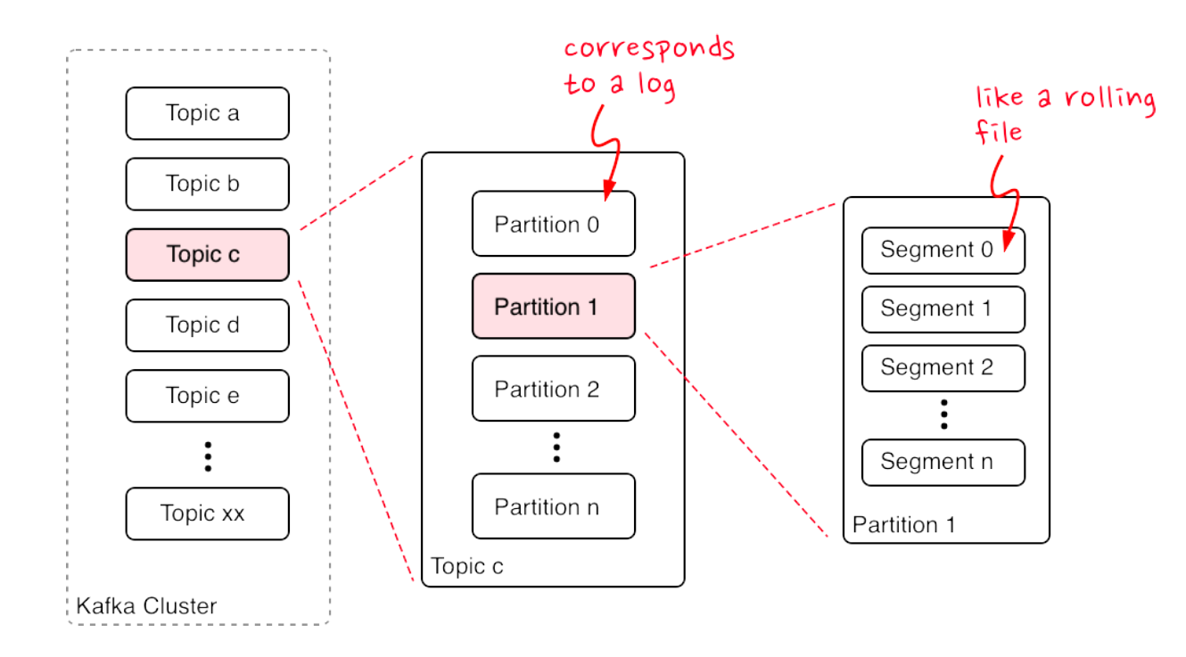
Topics, Partitions & Segments

Slide 13
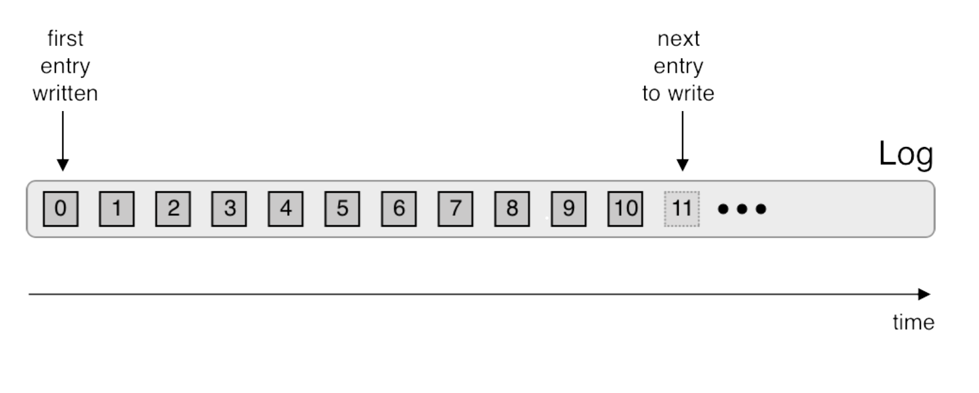
Logs

Slide 14
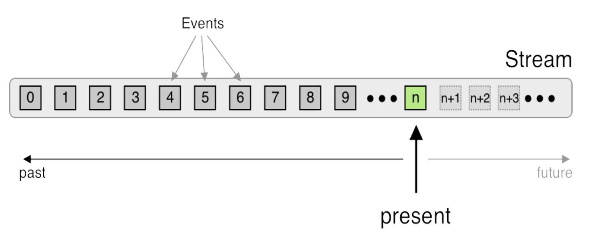
Stream

Slide 15
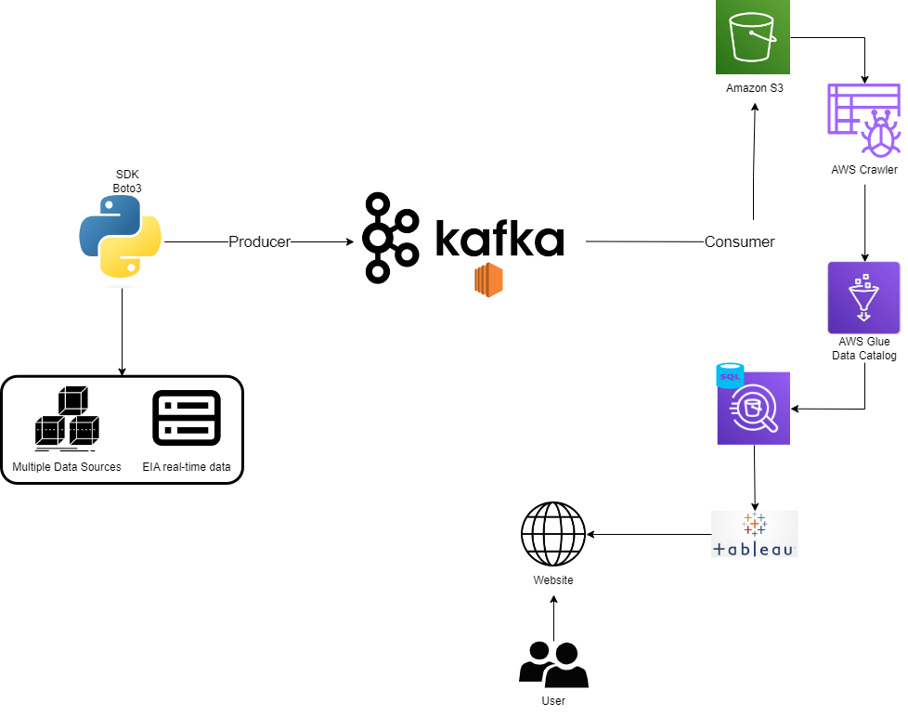
Project Architecture

Slide 16
Thank You

